Slide 2
ARTIFICIAL INTELLIGENCE AND CYBERSECURITY
NEW CHALLENGES OF AVIATION
THE ROLE OF TRAINING AND EDUCATION
The view of ENAC - Italian CAA
Roma 10 novembre 2023
Ing. Sebastiano Veccia
Notes:
Session title: THE VIEW OF INTERNATIONAL INSTITUTIONS AND NATIONAL REGULATORS
…after ICAO, EASA and Eurocontrol the view of Italian National Regulator: ENAC
Let me introduce myself..
As Director of ENAC Security Department I’ll propose to you a point of view very close by the "Information Security" prospective as in NIS Directive and EASA Part IS Regulations.
While aiming at harvesting the benefits of digital transformation in order to streamline operations or enhance its customers’ experience, aviation is evolving at a fast pace towards interconnection systems and the use of IA. The flipside of this transformation is the rising danger posed by cyberattacks that take the opportunities provided by a wider and sometimes unprotected attack surface.
ENAC actively works towards increasing the cybersecurity capabilities and the overall cyber resilience of the Italian Aviation Sector engaging in structured collaboration with ICAO, EASA, ECAC, Eurocontrol and other sectorial stakeholders.

Slide 3
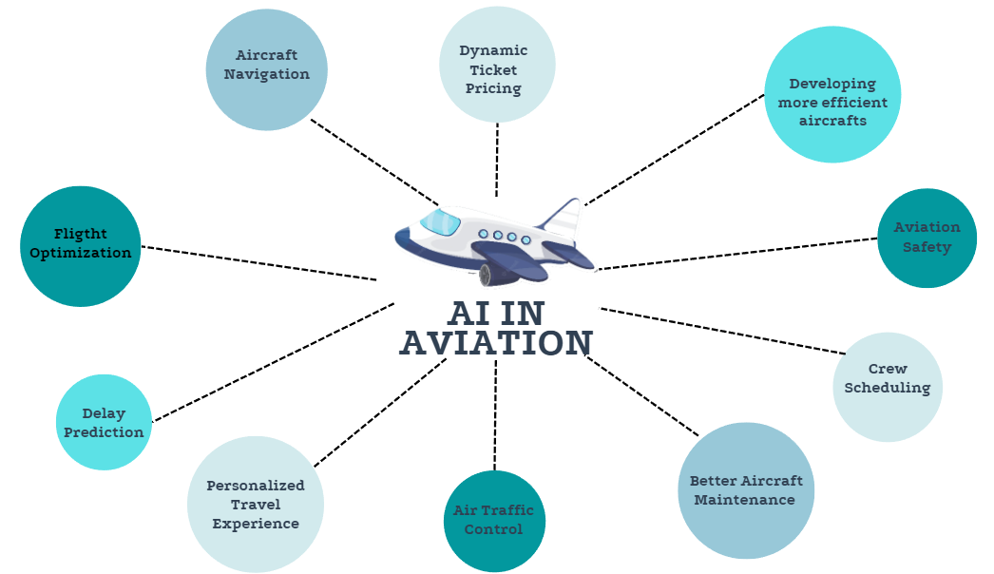
ARTIFICIAL INTELLIGENCE AND CYBERSECURITY / NEW CHALLENGES OF AVIATION / THE ROLE OF TRAINING AND EDUCATION
New Challenges
Roma 10 novembre 2023
Ing. Sebastiano Veccia
Notes:
Describe briefly for all bullet how AI may b e used and after emphasizes that all this way of using AI will require a specific Risk Analysis and Management for both information security and Cybersecurity.
Aircraft Navigation: AI could be used to an integrated and optimize merge between all air navigation services with new air navigation systems that manage the Telemetry Data with an Integrated system with Securing Encryption;
Dynamic Ticket Pricing: AI's economic analysis may be focusing simultaneous on: exercise costs, passengers request, events in sites departure or destination and customers profile optimizing the proposal cost of tickets and avoid fraud;
Developing more efficient Aircrafts: AI, using informations both aircraft and on route meteo should optimise aircraft fuel consumption and their amount of emission;
Aviation Safety: AI could be sign a new era of risk assessment and threat management;
Crew Scheduling: AI could be more efficient way to manage the rostering items and schedule the crew's rest time and turnover planning;
Better Aircraft Maintenance: AI may perform a realistic predictive-maintenance programmation merging specific aircraft’s records with worldwide maintenance big data of similar aircraft and/or in similar use conditions;
Air Traffic Control: development of efficient procedures to improve the performance of the national and international ATM network;
Personalized Travel Experience: customize the passengers profile, habits and preferences with the AI could be offer a tailorrized travel proposal for each passenger;
Delay prediction; all the improvements related with the use of AI in Aircraft Navigation and ATM may allow to predict delay whit extreme precision permitting better dutifulness of slots;
Flight Optimisation:all above holistically approached with AI resources could be reach a process of continuous and dynamic improvement of flights management until the target of autonomous flights.

Slide 4
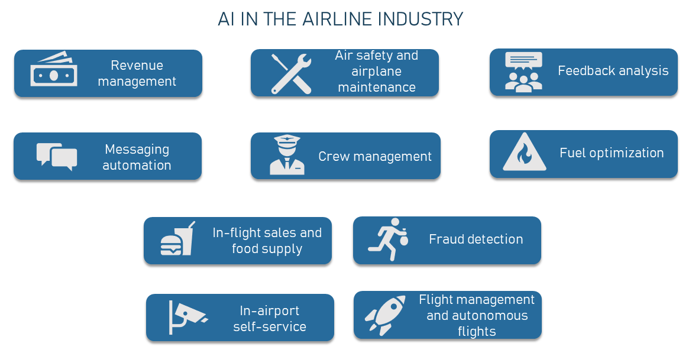
ARTIFICIAL INTELLIGENCE AND CYBERSECURITY / NEW CHALLENGES OF AVIATION / THE ROLE OF TRAINING AND EDUCATION
New Challenges
Roma 10 novembre 2023
Ing. Sebastiano Veccia
Notes:
In the previous slide we was seen how AI could be bring profound innovations to aviation industry and other organizations aviation related.
Here are the main field where now are on progress huge effort to implementation of AI use
Revenue Management: AI may steering business analysis
Air Safety and Airplane Management: AI consent predictive knowledge related to maintenance task and holistic approach to safety issue
Feedback analysis: AI analyze quickly big and non homogenous data
Messaging Automation: AI may manage in natural language complex concept message with a real time interaction with users
Crew Management: as showed in the previous slide
Fuel optimization: as showed in the previous slide
In-flight sales and food supply: as showed in the previous slide
Fraud detection: is a wide argument out of scope of this shot presentation
In-airport self-service: in check-in and face-ID boarding and security control AI may found facial expressions suspected
Flight management and autonomous flight: as showed in the previous slide
May be emphasizes that all this way of using AI will require a specific Risk Analysis and Management for both information security and Cybersecurity.

Slide 5
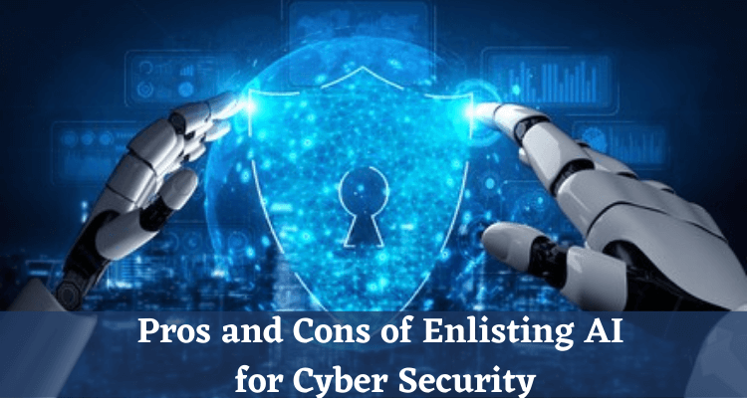
ARTIFICIAL INTELLIGENCE AND CYBERSECURITY / NEW CHALLENGES OF AVIATION / THE ROLE OF TRAINING AND EDUCATION
Civil Aviation
Roma 10 novembre 2023
Ing. Sebastiano Veccia
Notes:
Emerging technologies, such as AI, are rapidly transforming the aviation landscape.
AI-driven systems can analyze vast amounts of data to identify potential security breaches and anomalies, while automation streamlines air traffic management, reducing the risk of human error.
However, with these rapid technological advancements come new challenges.
Cyberattacks targeting critical aviation infrastructure, such as air traffic control systems or airline databases, pose a significant threat.
With the soaring Cybersecurity Risks in Aviation we need to really start focusing in on how we're going to adapt as quickly as necessary.

Slide 6
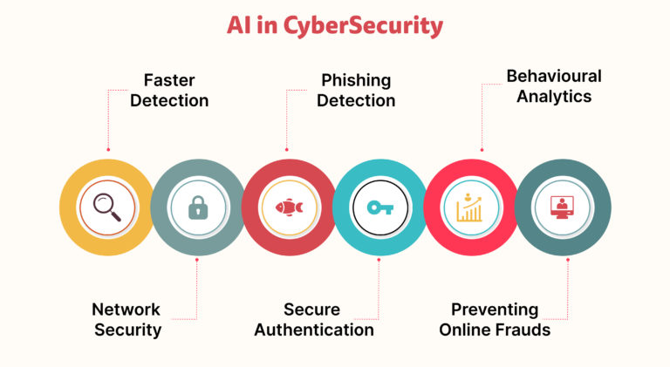
ARTIFICIAL INTELLIGENCE AND CYBERSECURITY / NEW CHALLENGES OF AVIATION / THE ROLE OF TRAINING AND EDUCATION
General Macro Aeras
Pros
Automation and Efficency in big data processing
Problem Solving and Decision Making 24/7
Cons
High Cost
Soaring of
Security Risks
Safety Risk Redution
Bugs or Bias in AI Algorithms
Weaponisation Faster
than Remediation
Stealing
Of Data
Use of AI for
Cyberattack
Manipulation
of Training Process
AI Code
Vulnerability
Roma 10 novembre 2023
Ing. Sebastiano Veccia
Notes:
Describe all this bullets shortly and summarize that the scope is use the pros to contrast the cons as follow
AI IMPROVE RESILIENCE because AI-driven systems:
Block sophisticated attack without human intervention;
Increase effectiveness and efficiency of cybersecurity Teams;
Response almost in real time when attack start;
Can mitigate quickly frauds.
AI REDUCE RISKS because AI-driven systems:
may do predictive risk management;
reduce operational cost (despite the high initial cost);
is able to auto consolidate the information security platform;
can assess proactively the compliance gap and suggest recovery measures.

Slide 7
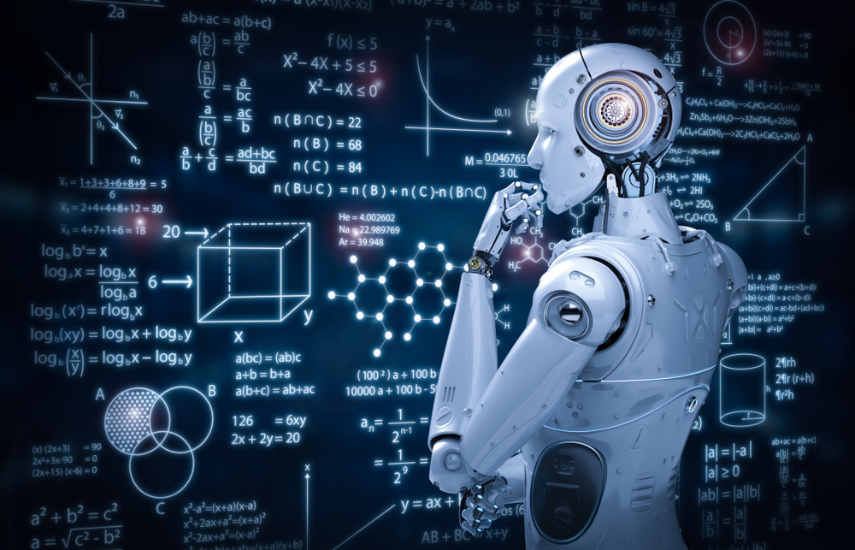
ARTIFICIAL INTELLIGENCE AND CYBERSECURITY / NEW CHALLENGES OF AVIATION / THE ROLE OF TRAINING AND EDUCATION
Training
&
Education
Roma 10 novembre 2023
Ing. Sebastiano Veccia
Notes:
The Role Of AI In Learning And Development:
One of the key areas where AI shines is around targeted, personalized, and tailored learning. Through sophisticated algorithms, AI can analyze individual employee performance and behavior through rapid and continuous analysis of their performance data.
Humans are at the base; whether it is the CEO or the end user.
For this reason the real challenge concerns proceeding quickly on the double track of Education and Training
Education to move from the perception of pros and cons to awareness of how use the pros to contrast the cons in a transversal and shared way for the entire organization and between organizations and Authorities
Training to develop skills and competence to exploit the pros and pursue innovation and sharing
Paramount in this will be the way (how deep and how extensive) that both the authorities and certified organizations in the civil aviation sector will intend use to implement AI in becoming compliant with the requirements of the two regulations (rules) of imminent application; Directive NIS2 and Regulation Part IS

Slide 8
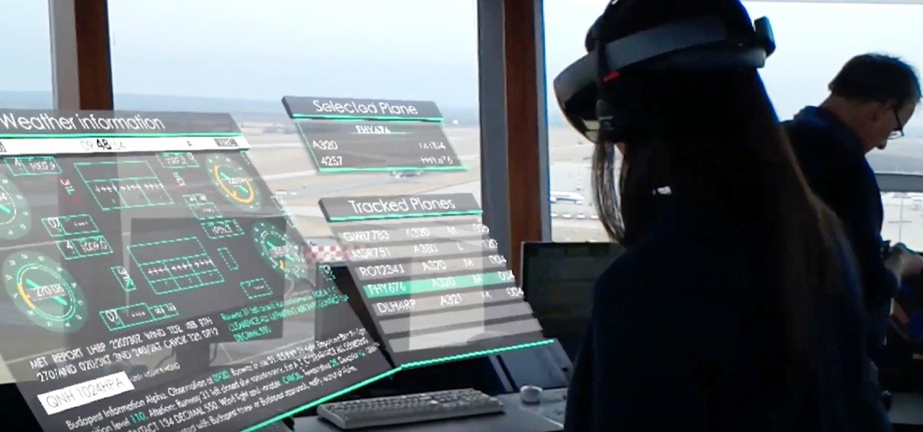
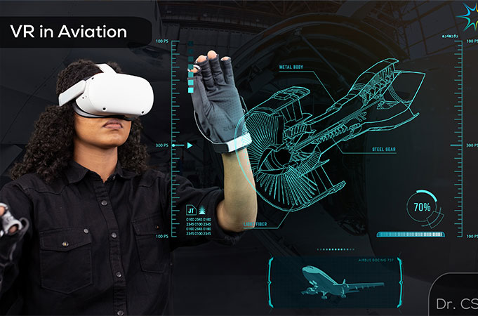
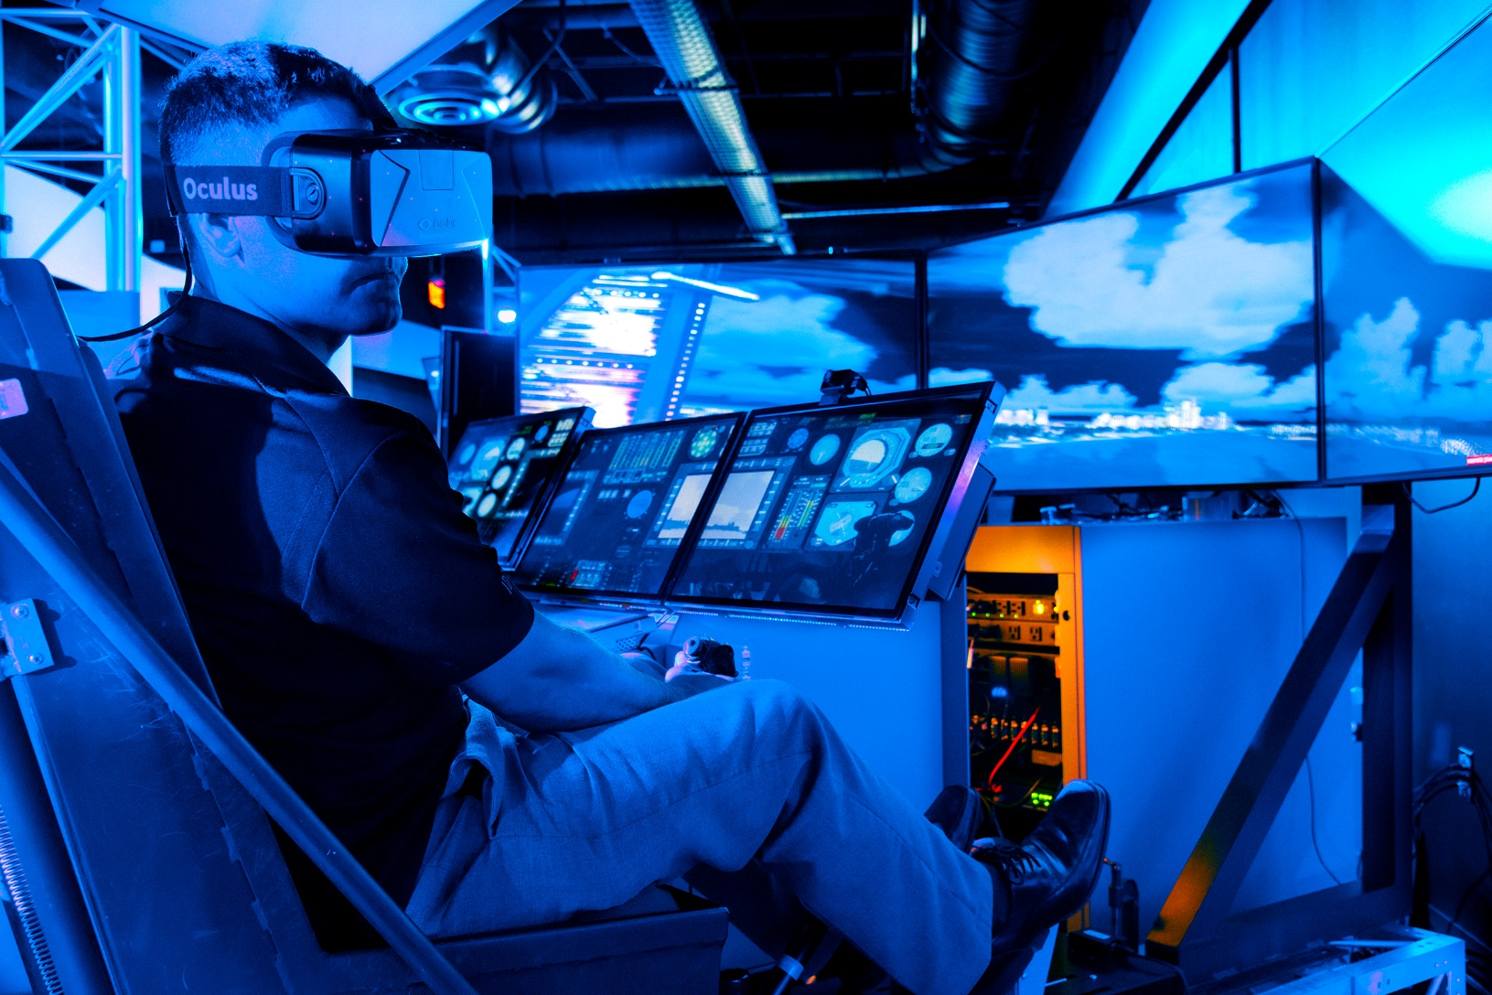
ARTIFICIAL INTELLIGENCE AND CYBERSECURITY / NEW CHALLENGES OF AVIATION / THE ROLE OF TRAINING AND EDUCATION
air traffic controllerers
engineers/workers
VR
AR
pilots
maintainers
Roma 10 novembre 2023
Ing. Sebastiano Veccia
Notes:
AI, Big Data with use of AR and or VR (augmented reality (AR), virtual reality (VR)) can be systematically and comprehensively applied to pilots, controllers, maintainers and aviation's engineers/workers training.
This provides real-time feedback and span across the various stages of training with an auto micro-adaptive learning approaches to training programs tailored these to individual pupils with varying learning styles and capabilities.
New advancements in machine learning and AI can be used to augment student learning and teacher capabilities. Examples of AI approaches in education include generating personalized student recommendations, autograding essays, and improving educational resources.

Slide 9
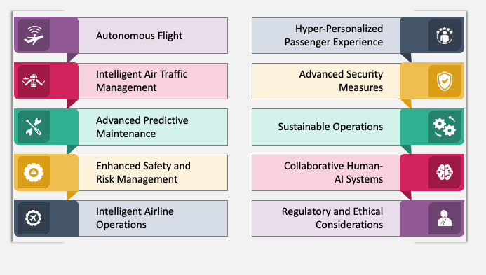
ARTIFICIAL INTELLIGENCE AND CYBERSECURITY / NEW CHALLENGES OF AVIATION / THE ROLE OF TRAINING AND EDUCATION
Future use of AI in Aviation
Roma 10 novembre 2023
Ing. Sebastiano Veccia
Notes:
Today the limit is our imagination and, as just exposed here we are a top ten of the fields where in the very near future the AI could be used massively in aviation

Slide 10
ARTIFICIAL INTELLIGENCE AND CYBERSECURITY / NEW CHALLENGES OF AVIATION / THE ROLE OF TRAINING AND EDUCATION
Conclusions
Roma 10 novembre 2023
Ing. Sebastiano Veccia
Notes:
Here is up to you decide which type of conclusions offer to the floor.
My suggestion?
Like in a review, follow the three pillar of this presentation (as in the title of the seminar):
AI in aviation open a new era with huge potential as happened for electronics device;
2) as with everything, even with AI we've pros and cons; generals and specific for the cybersecurity issues;
3) among the match points between AI and humans one of the much up-and-coming is related to the training and education applications.

Slide 11
ARTIFICIAL INTELLIGENCE AND CYBERSECURITY / NEW CHALLENGES OF AVIATION / THE ROLE OF TRAINING AND EDUCATION
QUESTIONS
Roma 10 novembre 2023
Ing. Sebastiano Veccia
Notes:
Here’s your own affair.. ;-)

